Slide 1
Articulations (Joints)

Slide 2
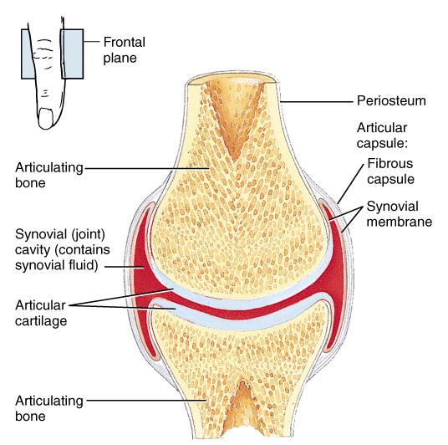
Articulations (Joints)
Joints hold bones together but permit movement (with a few exceptions)
Point of contact
between 2 bones
between cartilage and bone
between teeth and bones
Arthrology = study of joints
Kinesiology = study of motion

Slide 3
Classification of Joints
Structural classification
Fibrous
Cartilaginous
Synovial
Functional classification based upon movement:
immovable = synarthrosis
slightly movable = amphiarthrosis
freely movable = diarthrosis

Slide 4
Structural Classification 1. Fibrous Joints
Lack a synovial cavity
Bones held close
Little (amphiarthroses) or no movement (synarthroses )

Slide 5
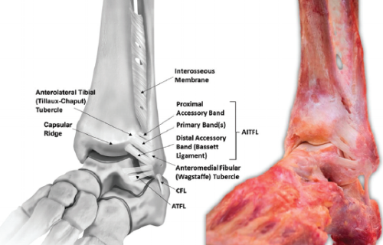
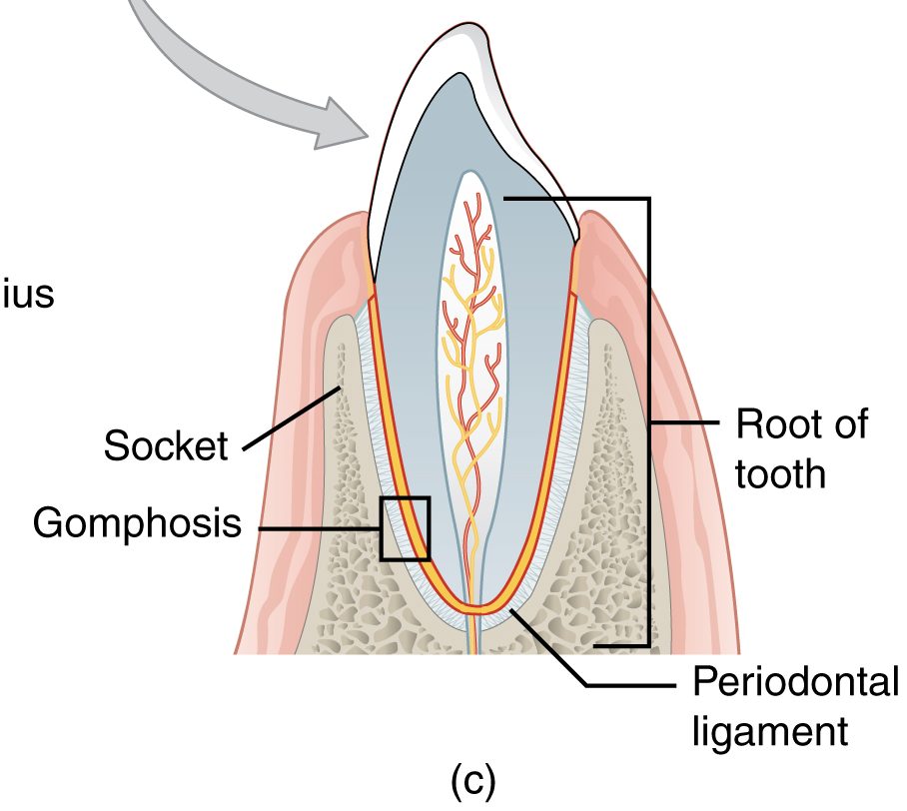
Structural Classification 1.Fibrous Joints
2 structural types of fibrous joint
sutures
Syndesmoses
A syndesmosis is defined as a fibrous joint in which two adjacent bones are linked by a strong membrane or ligaments. This definition also applies for the distal tibiofibular syndesmosis*.
Interosseous membrane may be found between two bones forming a syndesmosis joint.
Gomphoses – special case - tooth in the socket
*Hermans JJ, Beumer A, de Jong TA, Kleinrensink GJ. Anatomy of the distal tibiofibular syndesmosis in adults: a pictorial essay with a multimodality approach. J Anat. 2010 Dec;217(6):633-45. doi: 10.1111/j.1469-7580.2010.01302.x. PMID: 21108526; PMCID: PMC3039176. 5

Slide 6
Structural Classification 2. Cartilaginous Joints
Lacks a synovial cavity
Allows little (amphiarthroses) or no movement (synarthroses )
Bones tightly connected by fibrocartilage or hyaline cartilage
2 types
synchondroses
symphyses

Slide 7
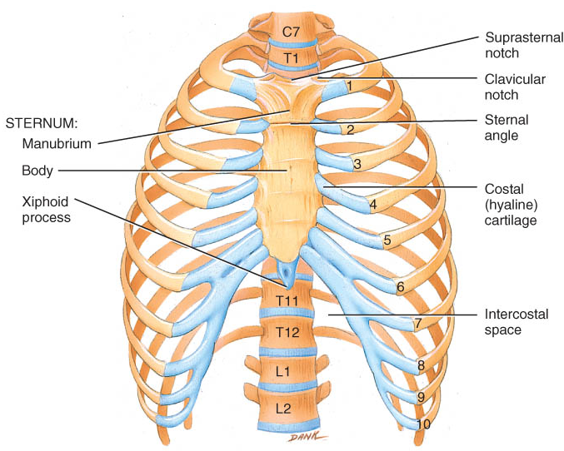
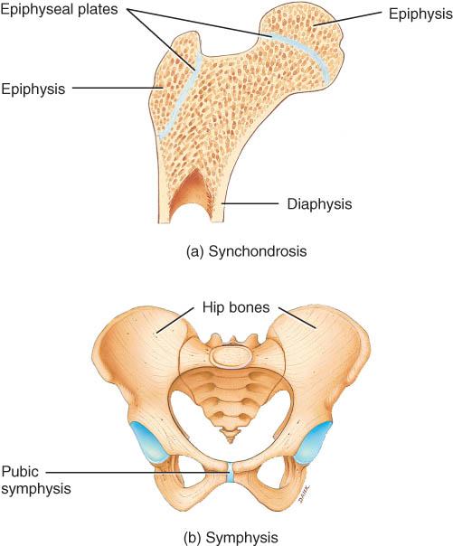
2. Cartilaginous Joint - Synchondrosis
Connecting material is hyaline cartilage
Immovable (synarthrosis)
Epiphyseal plate or joints between ribs and sternum

Slide 8
2. Cartilaginous Joint - Symphysis
Ends of the articulating bones are covered with hyaline cartilage but fibrocartilage is connecting material
Slightly movable (amphiarthroses)
Intervertebral discs and pubic symphysis

Slide 9
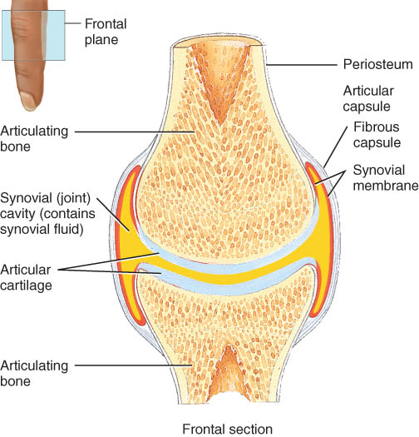
Structural Classification 3.Synovial Joints
Synovial cavity separates articulating bones
Freely moveable (diarthroses)
Articular cartilage
Hyaline cartilage
reduces friction
absorbs shock
Articular capsule
surrounds joint
thickenings in fibrous capsule called ligaments
Synovial membrane
inner lining of capsule

Slide 10
Structural Classification 3.Synovial Joints
Synovial Fluid
Secreted by the synovial membrane
contains slippery hyaluronic acid
Functions:
Reduces friction
Absorbs shocks
Supplies oxygen and nutrients
Removes carbon dioxide and wastes
Has phagocytic cells
Fun fact:
When a synovial joint is immobile for a while…..

Slide 11
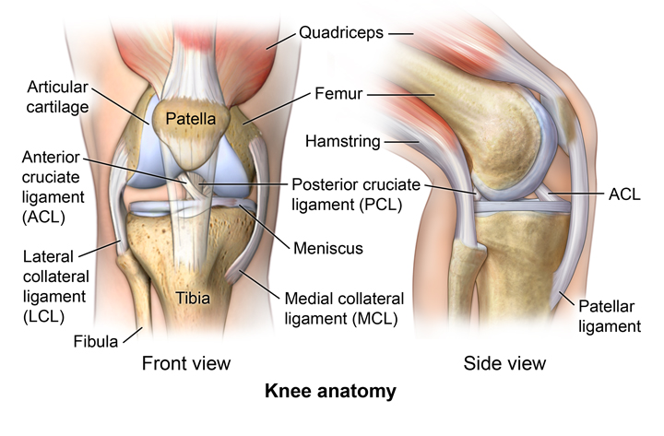
Structural Classification 3.Synovial Joints – Special Features
Accessory ligaments
extracapsular ligaments
outside joint capsule
Fibular and tibial collalateral ligaments
intracapsular ligaments
within capsule
ACL and PCL
Articular discs or menisci
attached around edges to capsule
allow 2 bones of different shape to fit tightly
increase stability of knee - torn cartilage

Slide 12
Nerve and Blood Supply
Nerves to joints are branches of nerves to nearby muscles
Joint capsule and ligaments contain pain fibers and sensory receptors
Blood supply to the structures of a joint are branches from nearby structures

Slide 13
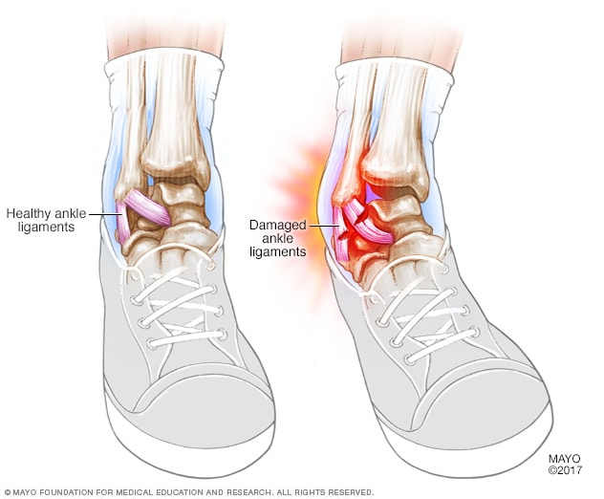
Sprain versus Strain
Sprain
twisting of joint that stretches or tears ligaments
may damage nearby blood vessels
swelling & hemorrhage from blood vessels
Strain
overstretched or partially torn muscle or muscle tendon

Slide 14
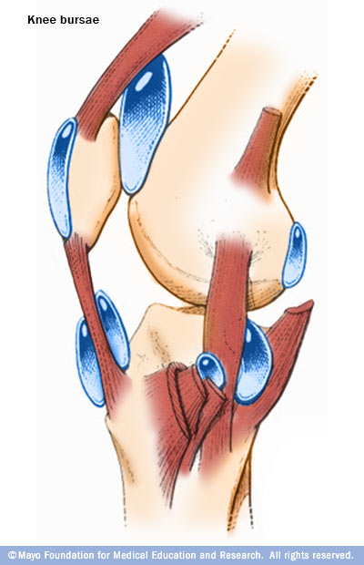
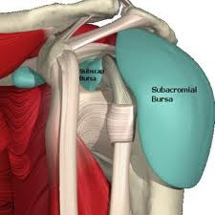
Bursae and Tendon Sheaths
Bursae
fluid-filled saclike extensions of the joint capsule
reduce friction between moving structures
Tendon sheaths
tubelike bursae that wrap around tendons at wrist and ankle where many tendons come together in a confined space
Bursitis
chronic inflammation of a bursa

Slide 15
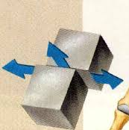
Types of Movement at Synovial Joints
Gliding movements occur when relatively flat bone surface move back and forth and from side to side with respect to one another.
Examples: carpals and tarsals

Slide 16
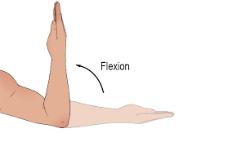
Types of Movement at Synovial Joints
In angular movements there is an increase or a decrease in the angle between articulating bones.
Flexion results in a decrease in the angle between articulating bones.
https://mammothmemory.net/

Slide 17
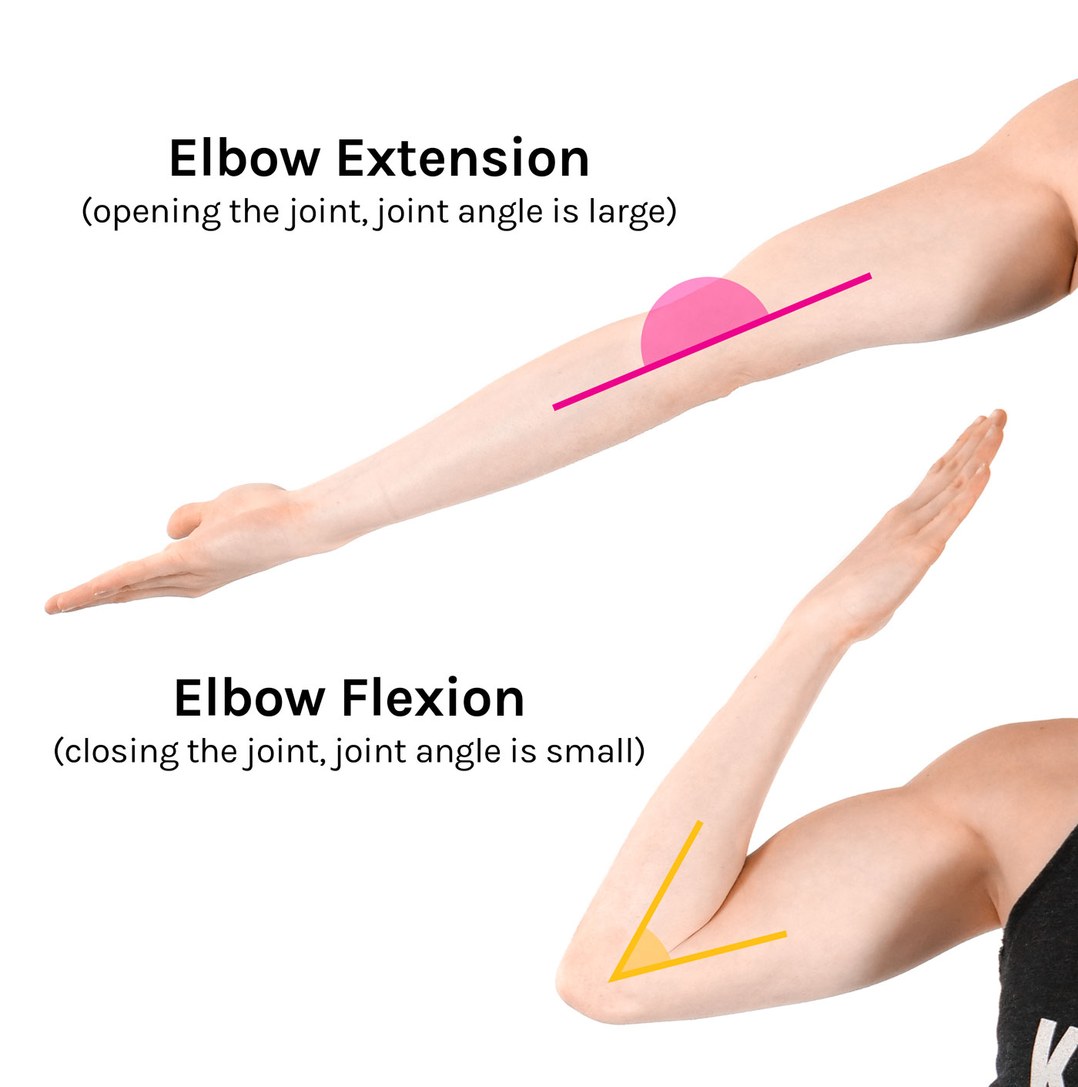
Types of Movement at Synovial Joints
In angular movements there is an increase or a decrease in the angle between articulating bones.
Extension results in an increase in the angle between articulating bones.
https://tommorrison.uk/blog/flexion--extension-in-detail

Slide 18
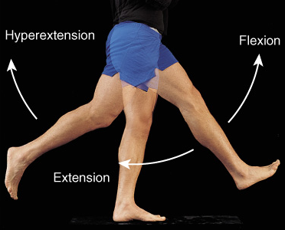
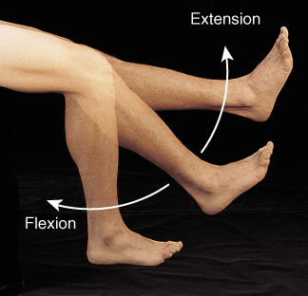
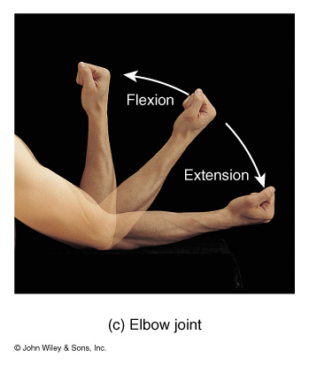
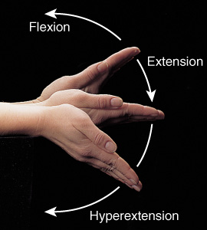
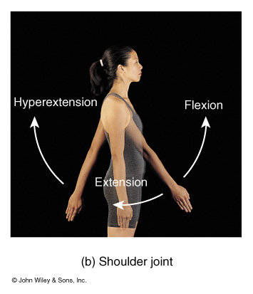
Flexion, Extension & Hyperextension

Slide 19
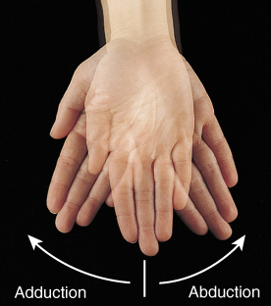
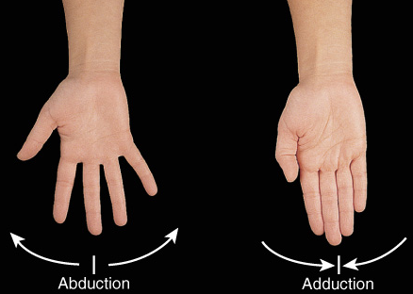
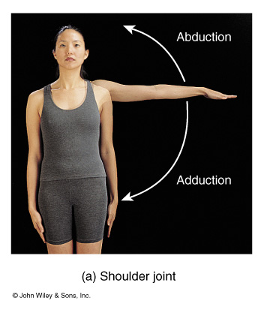
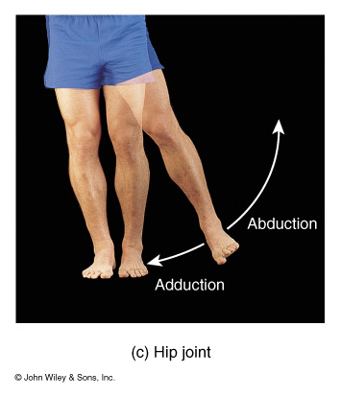
Abduction and Adduction
Condyloid joints
Ball and Socket joints

Slide 20
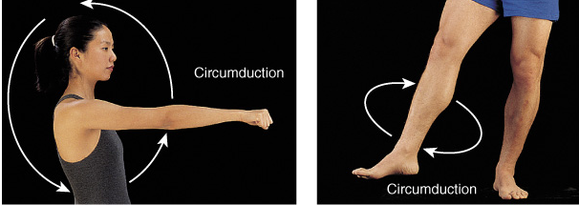
Circumduction
Movement of a distal end of a body part in a circle
Combination of flexion, extension, adduction and abduction
Occurs at ball and socket, saddle and condyloid joints

Slide 21
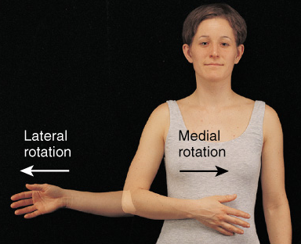
Rotation
Bone revolves around its own longitudinal axis
medial rotation is turning of anterior surface in towards the midline
lateral rotation is turning of anterior surface away from the midline
At ball & socket and pivot type joints

Slide 22
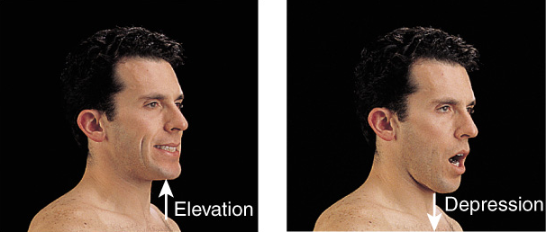
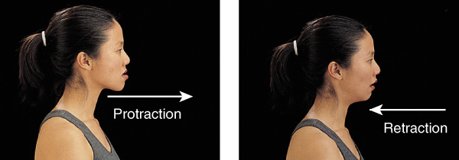
Special Movements of Mandible
Elevation = upward
Depression = downward
Protraction = forward
Retraction = backward

Slide 23
Special Movement terms for hand and foot
Inversion/supination is movement of the soles medially at the intertarsal joints so that they face toward each other.
Eversion/pronation is a movement of the soles laterally at the intertarsal joints so that they face away from each other.
Dorsiflexion refers to bending of the foot at the ankle in the direction of the superior surface.
Plantar flexion involves bending of the foot at the ankle joint in the direction of the plantar surface.
Pronation refers to rotation of the hand and forearm so that the palm faces backwards or downwards
Supination refers to rotation of the hand and forearm so that the palm faces forwards or upwards

Slide 24
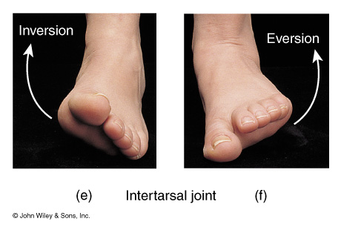
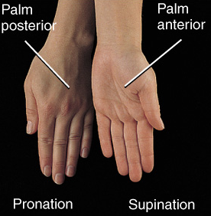
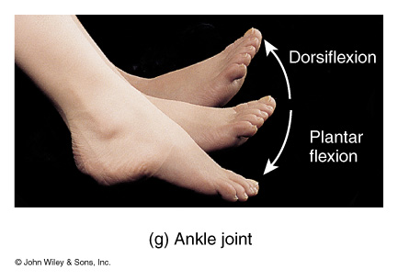
Special Hand & Foot Movements
Inversion/supination
Eversion/pronation
Dorsiflexion
Plantarflexion
Pronation
Supination

Slide 25
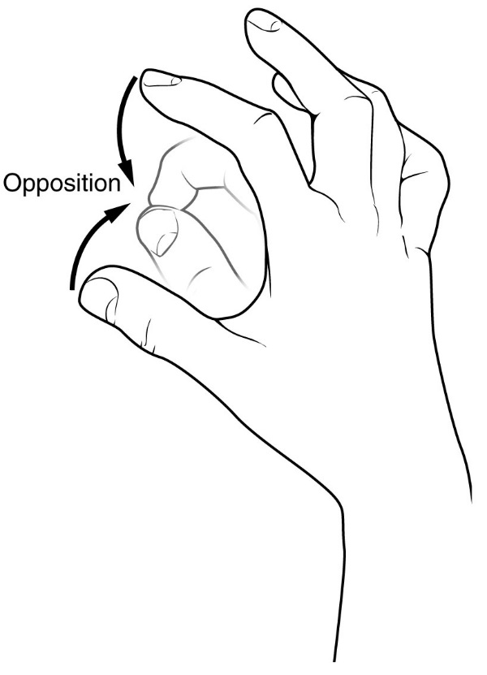
Special Movement terms for hand and foot
Opposition is the movement of the thumb at the carpometacarpal joint in which the thumb moves across the palm to touch the tips of the finger on the same hand.

Slide 26
TYPES OF SYNOVIAL JOINTS and MOVEMENTS
Planar joint
Hinge joint
Pivot joint
Condyloid or Ellipsoidal joint
Saddle joint
Ball and Socket joint

Slide 27
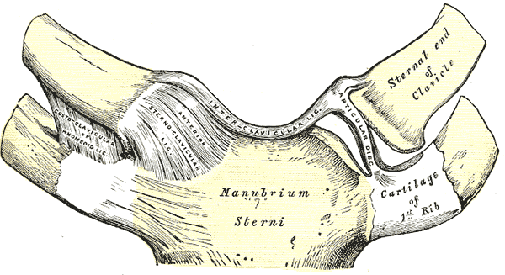
Planar Joint
Planar joints permit mainly gliding movements
side-to-side and back-and-forth
Bone surfaces are flat or slightly curved
Rotation prevented by ligaments
Examples
intercarpal or intertarsal joints
sternoclavicular joint
vertebrocostal joints

Slide 28
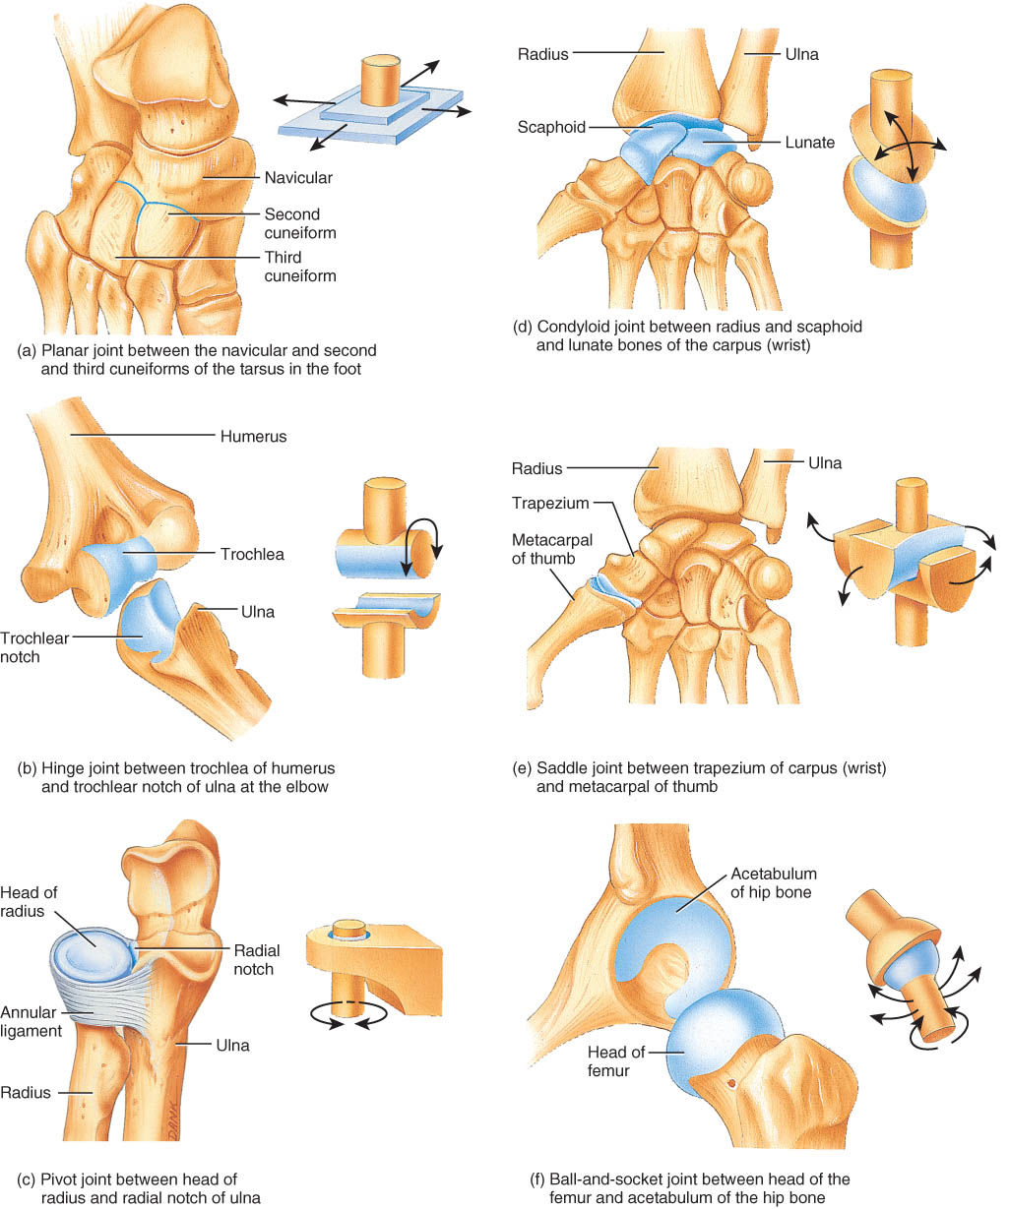
Hinge Joint
Convex surface of one bones fits into concave surface of 2nd bone
Uniaxial like a door hinge
Examples
Knee, elbow, ankle, interphalangeal joints
Movements produced
flexion = decreasing the joint angle
extension = increasing the angle
hyperextension = opening the joint beyond the anatomical position

Slide 29
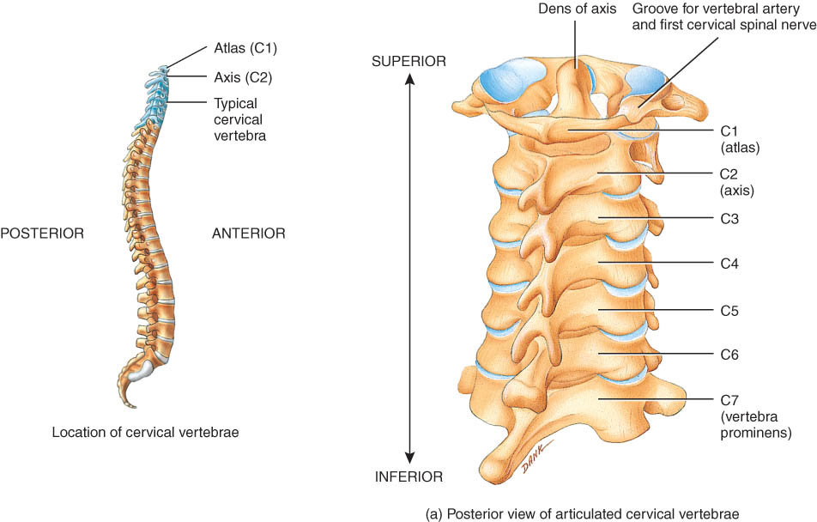
Pivot Joint
Rounded surface of bone articulates with ring formed by 2nd bone & ligament
Uniaxial since it allows only rotational movement around longitudinal axis
Examples
Proximal radioulnar joint
supination
pronation
Atlanto-axial joint
turning head side to side “no”

Slide 30
Condyloid or Ellipsoidal Joint
Oval-shaped projection fits into oval depression
Biaxial = flex/extend or abduct/adduct is possible
Examples
wrist and metacarpophalangeal joints for digits 2 to 5

Slide 31
Saddle Joint
One bone saddled-shaped; other bone fits as a person would sitting in that saddle
Biaxial
Circumduction allows tip of thumb travel in circle
Opposition is the movement of the thumb at the carpometacarpal joint in which the thumb moves across the palm to touch the tips of the finger on the same hand.
Example
trapezium of carpus and metacarpal of the thumb

Slide 32
Ball and Socket Joint
Ball fitting into a cuplike depression
Multiaxial
flexion/extension
abduction/adduction
Rotation
Circumduction
Examples (only two!)
shoulder joint
hip joint

Slide 33
Summary of the types of movements
Gliding
Angular
Flexion
Extension
Hyperextension
Rotation
Abduction and Adduction
Circumduction

Slide 34
FACTORS AFFECTING RANGE OF MOTION AT SYNOVIAL JOINTS
Structure and shape of the articulating bone
Strength and tautness of the joint ligaments
Arrangement and tension of the muscles
Contact of soft parts
Hormones
Disuse

Slide 35
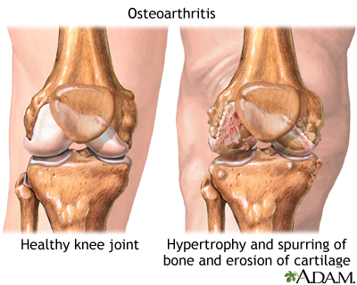
AGING AND JOINTS
Various aging effects on joints include decreased production of synovial fluid, a thinning of the articular cartilage, and loss of ligament length and flexibility.
The effects of aging on joints are due to genetic factors as well as wear and tear on joints.

Slide 36
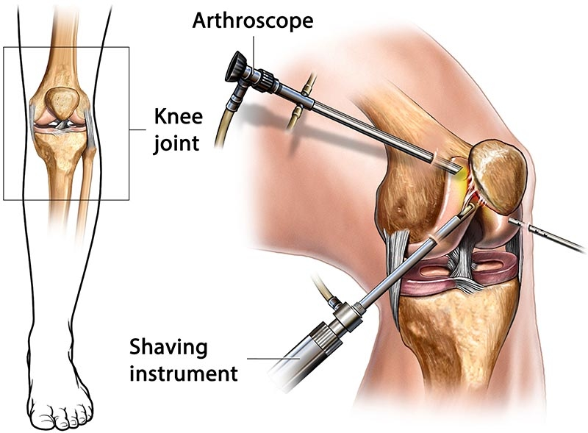
Arthroscopy
Arthroscopy = examination of joint
instrument size of pencil
remove torn knee cartilages & repair ligaments
small incision only

Slide 37
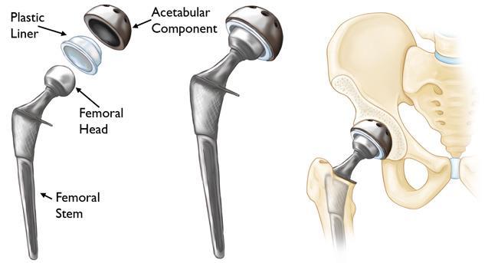
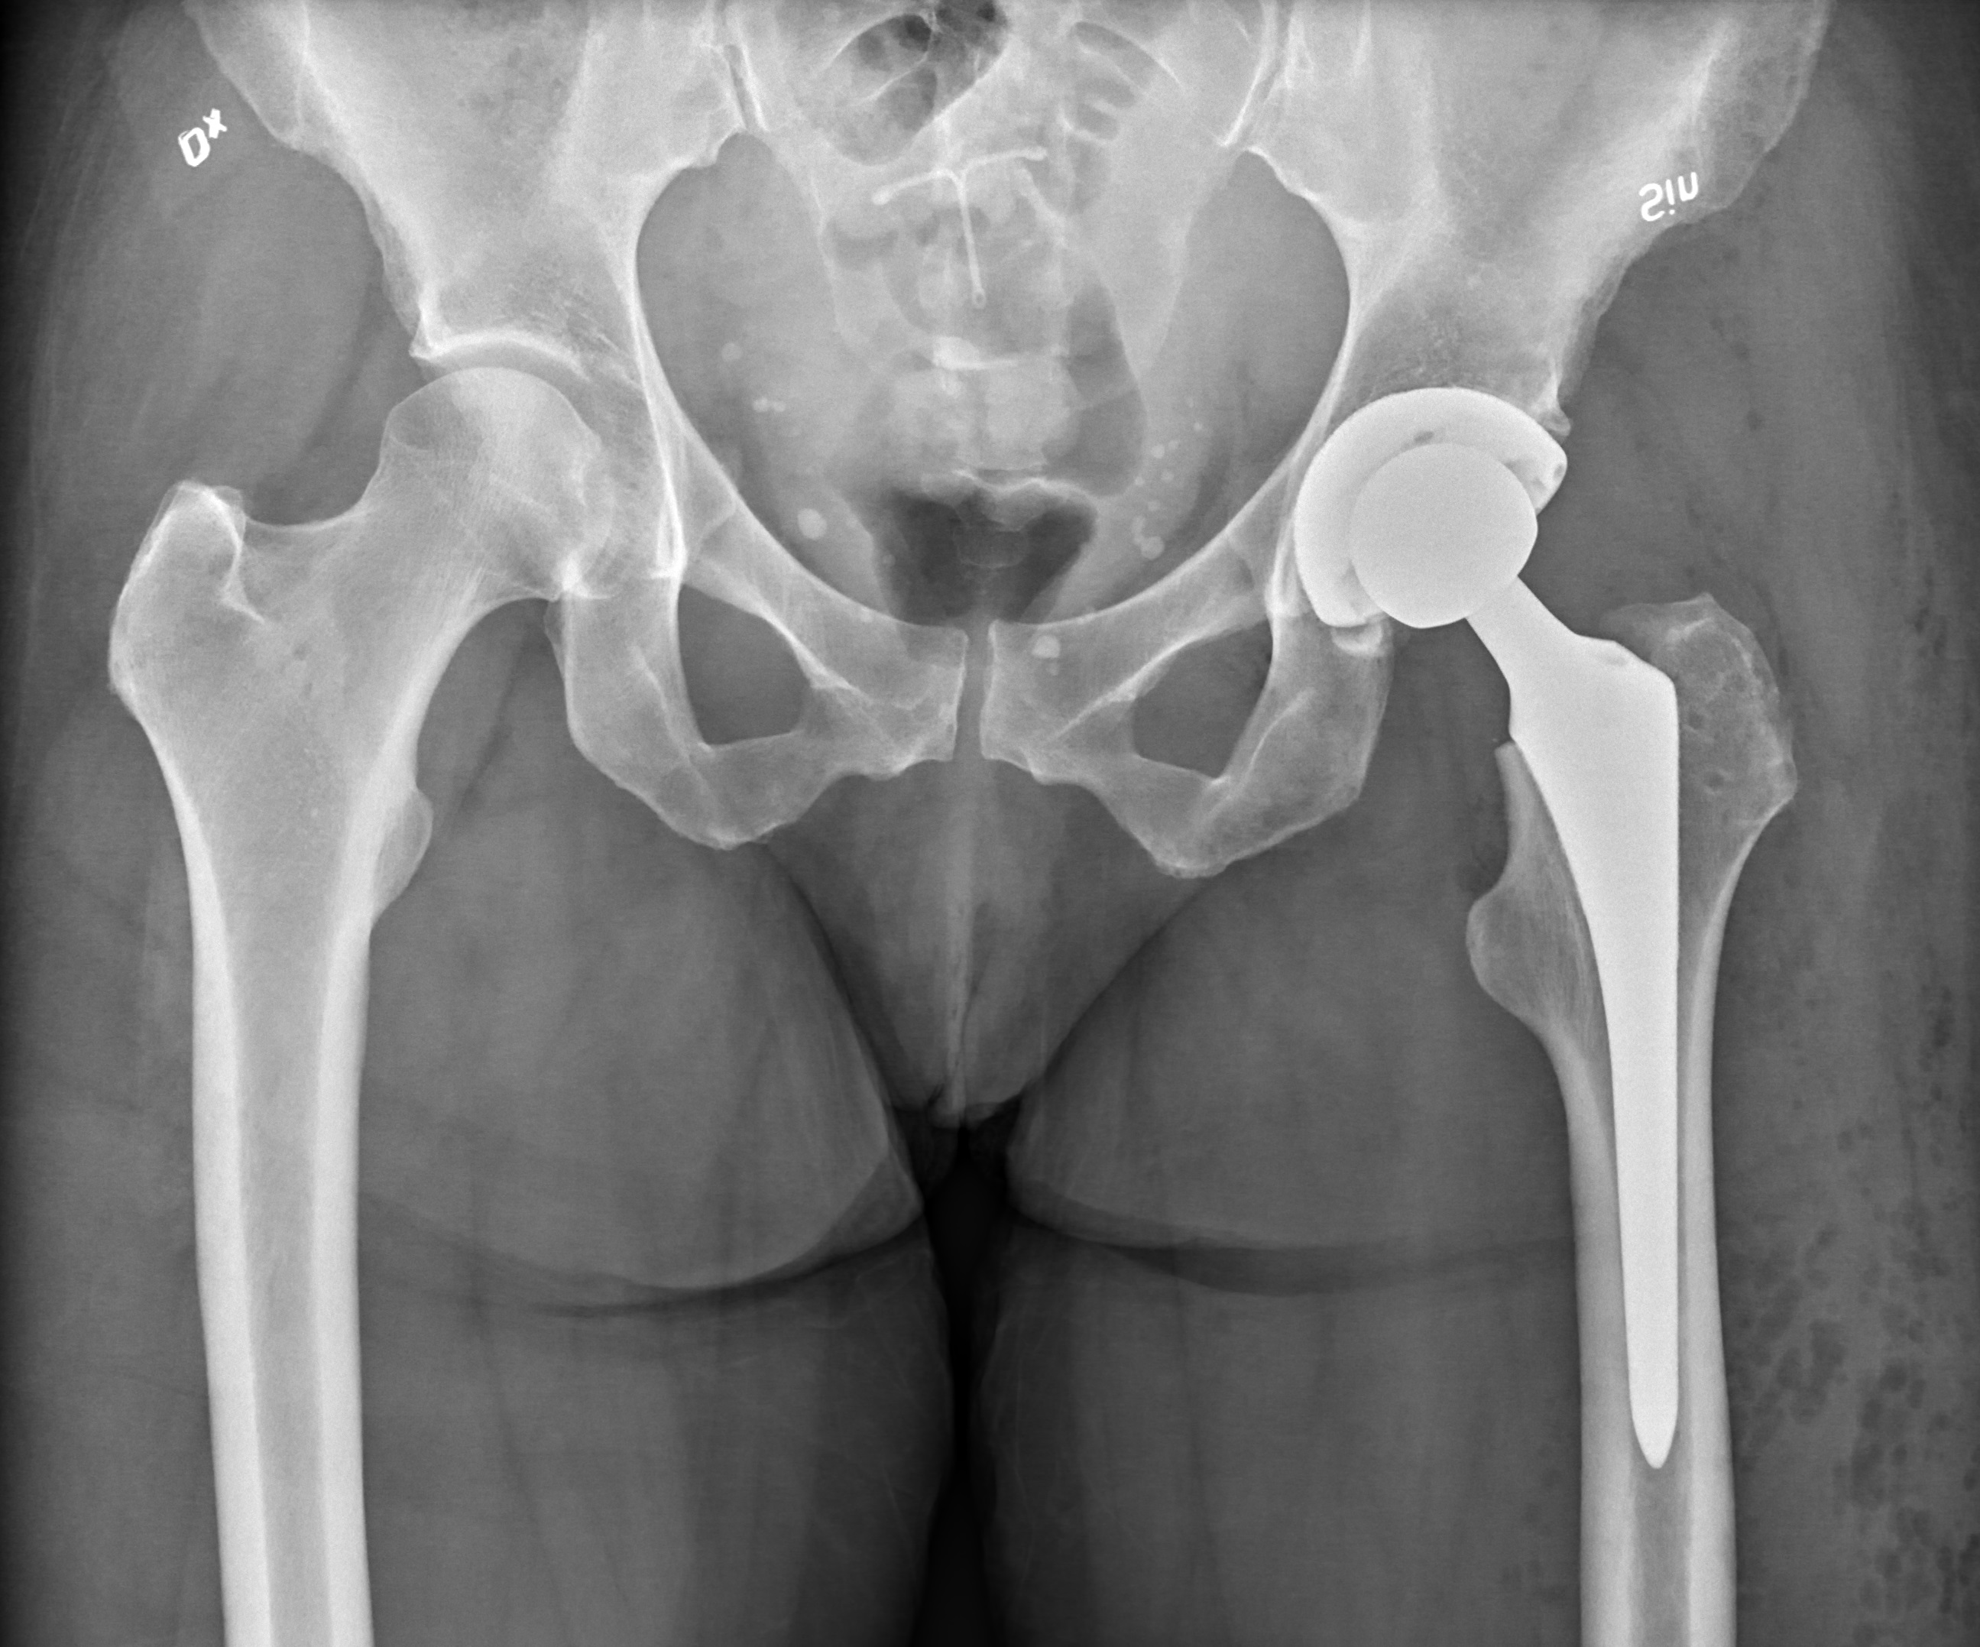
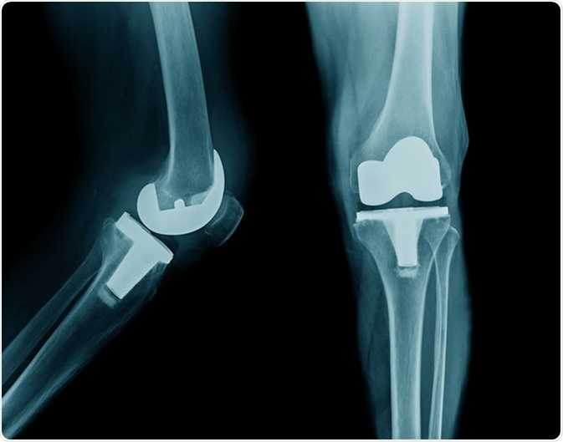
Arthroplasty
Arthroplasty = replacement of joints
total hip replaces acetabulum & head of femur
knee replacement common

Slide 38
Three Types of Arthritis
Rheumatoid arthritis
Osteoarthritis
Gout

Slide 39
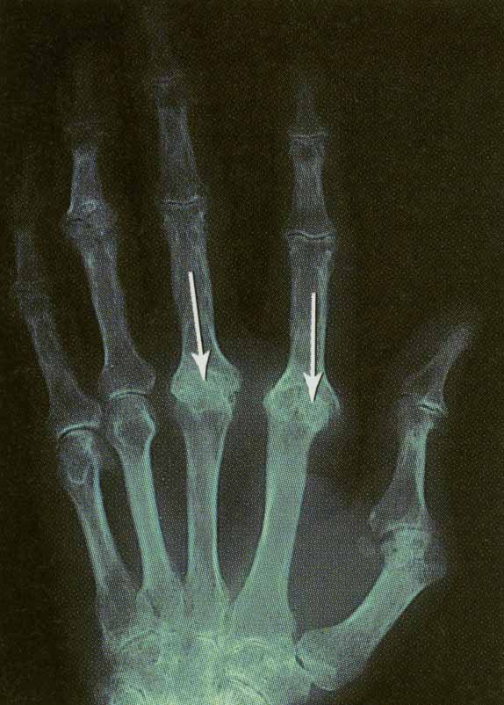
Rheumatoid Arthritis
Autoimmune disorder
Cartilage attacked
Inflammation, swelling & pain
Final step is fusion of joint

Slide 40
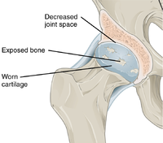
Osteoarthritis
Degenerative joint disease
aging, wear & tear
Noninflammatory---no swelling
only cartilage is affected not synovial membrane
Deterioration of cartilage produces bone spurs
restrict movement
Pain upon awakening--disappears with movement

Slide 41
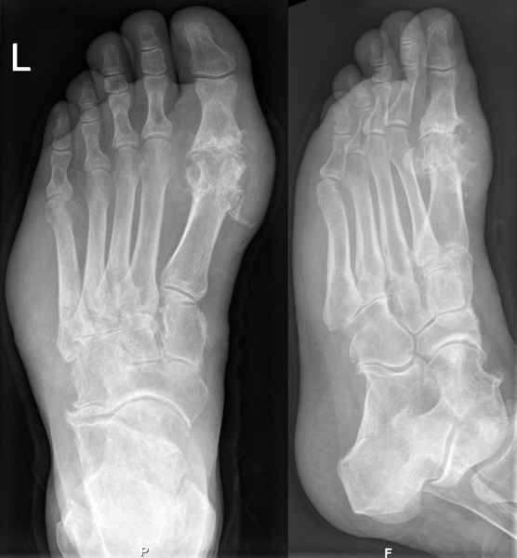
Gouty Arthritis
Urate crystals build up in joints---pain
waste product of DNA & RNA metabolism
builds up in blood
deposited in cartilage causing inflammation & swelling
Bones fuse
Middle-aged men with abnormal gene

Slide 42
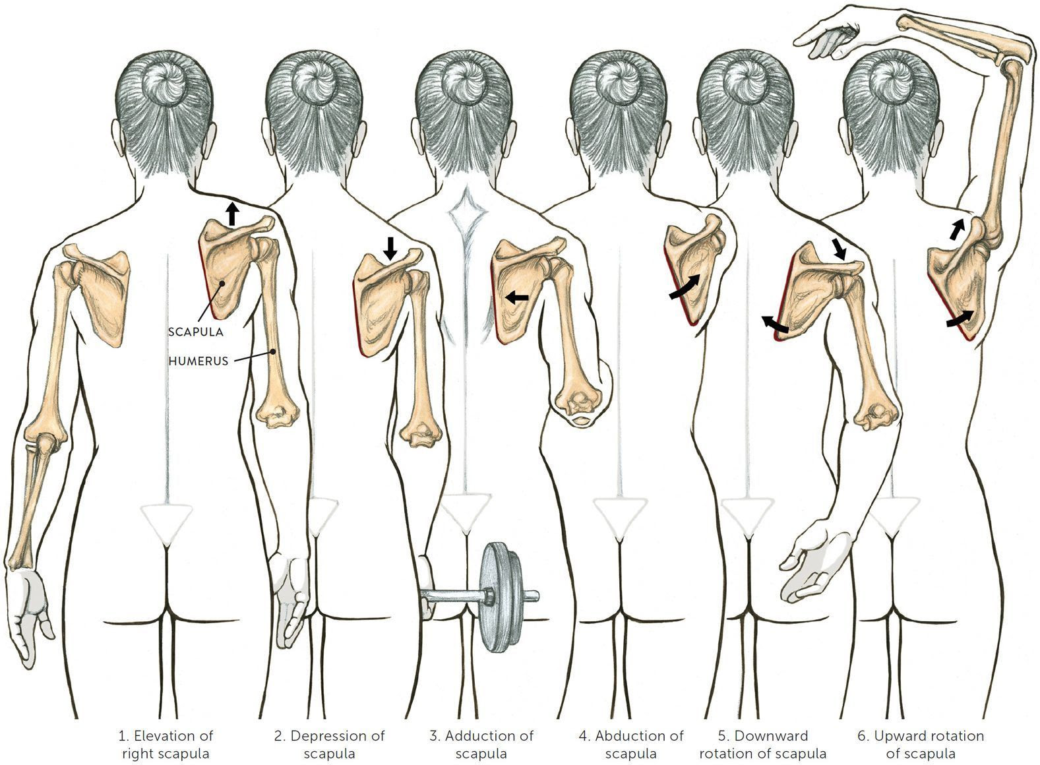






Special Movements of Scapula
This slide is just for your review

